Slide 1

How do Organisms
Reproduce?
Modes of reproduction used by single organisms
(Regeneration)

Slide 2
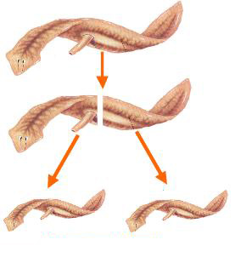
Regeneration
Many fully differentiated organisms have the ability to give rise to new organisms from their body parts.
If the individual is cut or broken into many pieces- these pieces grow into separate individuals.

Slide 3

Let us find out how does this happen???

Slide 4
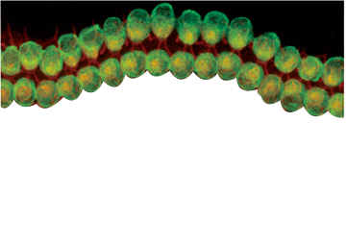
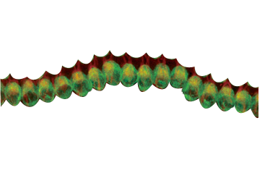
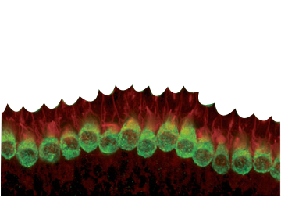





Regeneration
Specialized cells
proliferate
to grow or produce by multiplication (cell division)
Large number of cells
Cells types and tissues changes
Organised sequence
development

Slide 5
Regeneration
Regeneration is not the same as reproduction
Regeneration is the reconstruction of entire body from the isolated body cells when the organism body gets cut into pieces.
But animals cannot wait to be cut to reproduce. Therefore, regeneration is not the same as reproduction.

Slide 6
Thank You

